Slide 1


QR Code.FREE
Fast – Reliable – Effective – Easy

Slide 2
Content
01
What
Description of the project
02
Who
Description of the target audience
03
Why
Description the value for the user
04
Demo

Slide 3
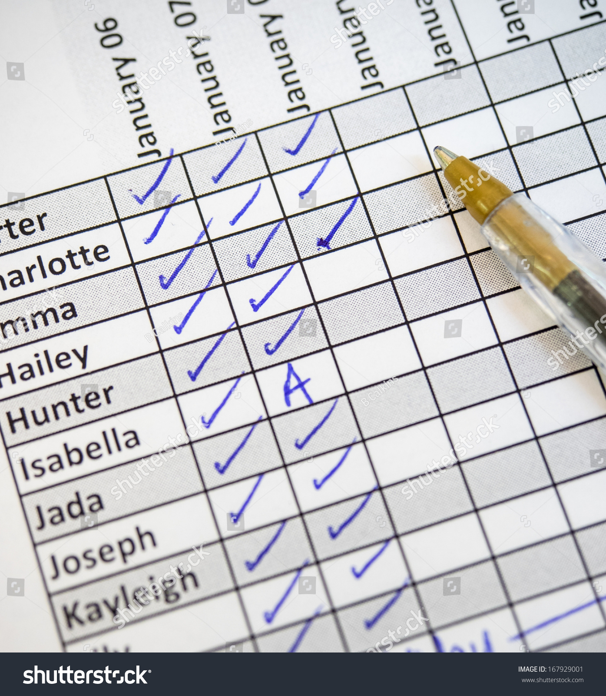


True Story

Slide 4

SOCIAL MEDIA
95%
Of the employees have mobile phones [ ECAR ]

Slide 5
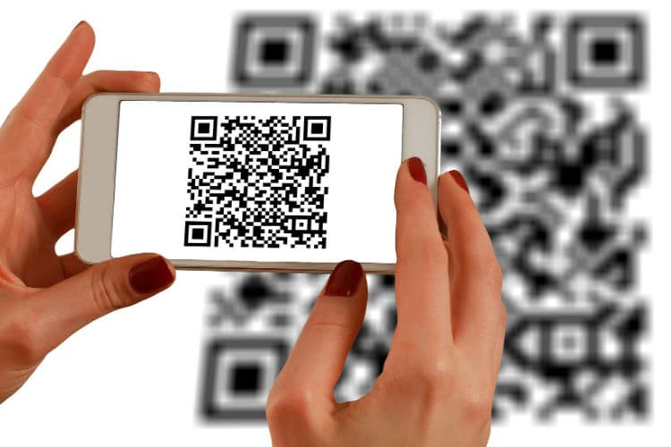
Our Solution

Slide 6
Our Values
QR Code.FREE
Fast
1
Reliable
2
Effective
3
Easy
4

Slide 7

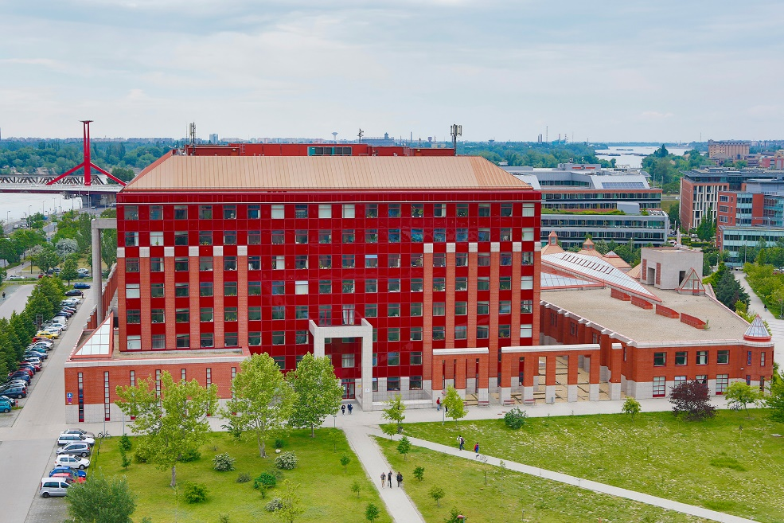



Our
Customers

Slide 8
Cheat me again if you can …

Slide 9

Demo Time

